Slide 1




IBM COGNOS ANALYTICS
DESCRIPTIVE ANALYTICS
Dataset: netflix_titles.csv
Group Members
Aman Kr Panday
Abhishek Dwivedi
Aman Bhardwaj
Akhil Raj Patel
Aman Kumar Panday
Course: BCA – Data Science & AI (3rd Semester)
Babu Banarasi Das University, Lucknow

Slide 2
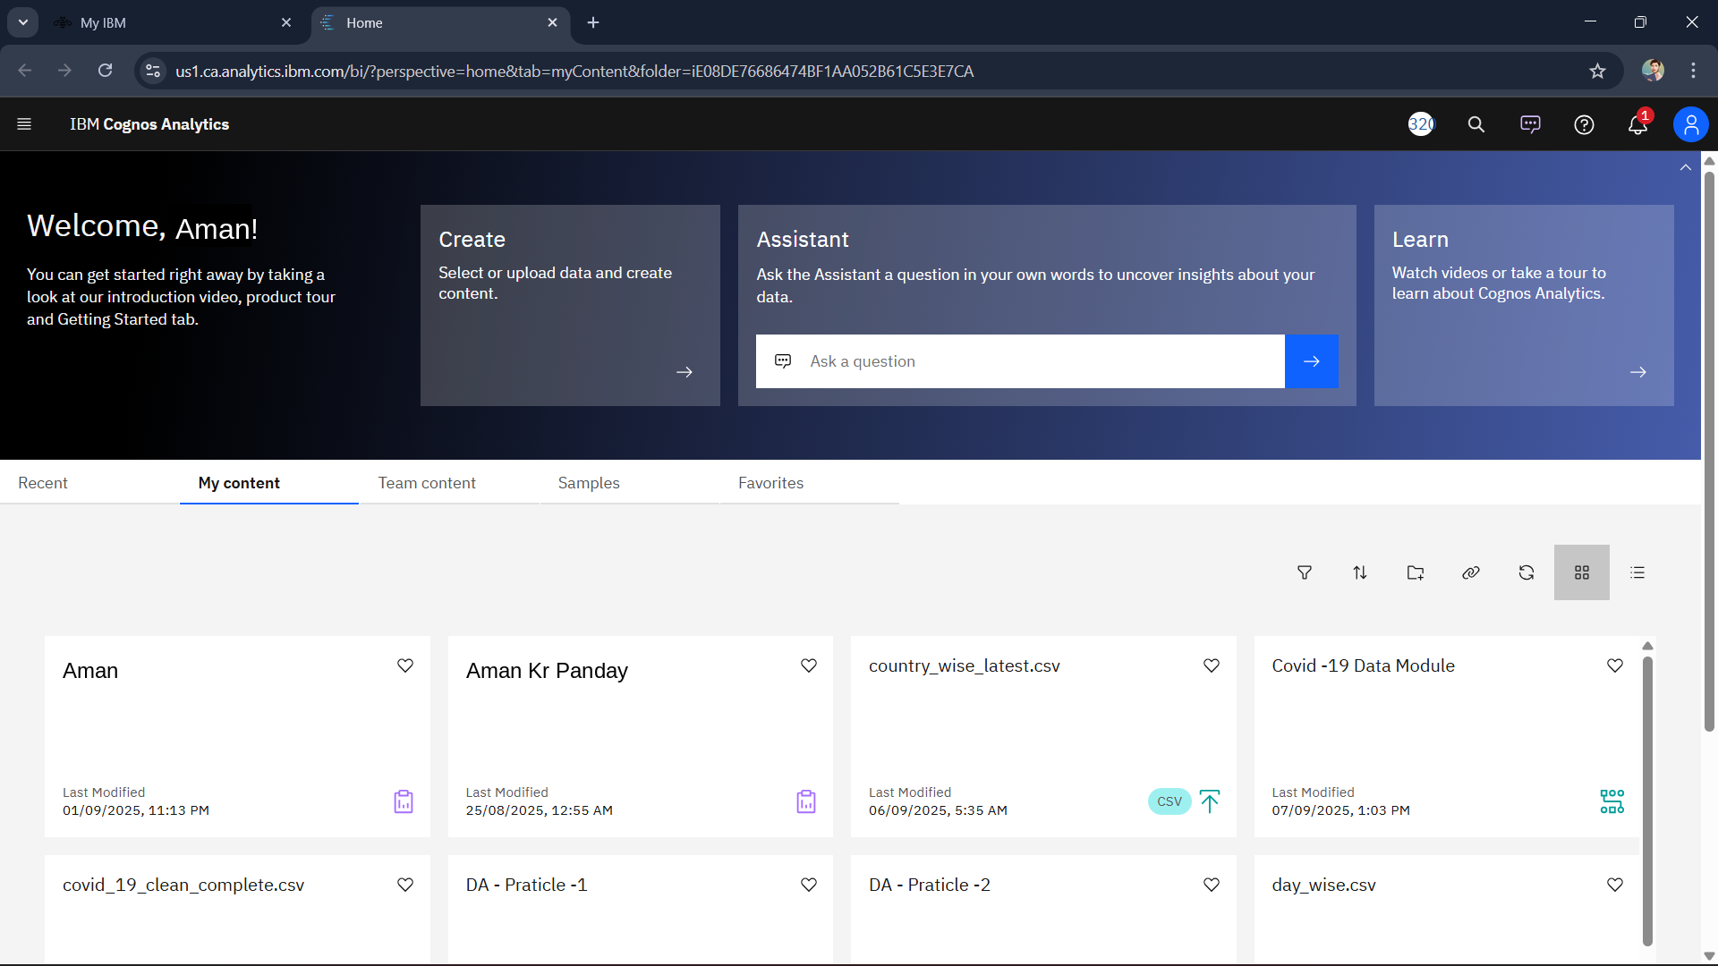
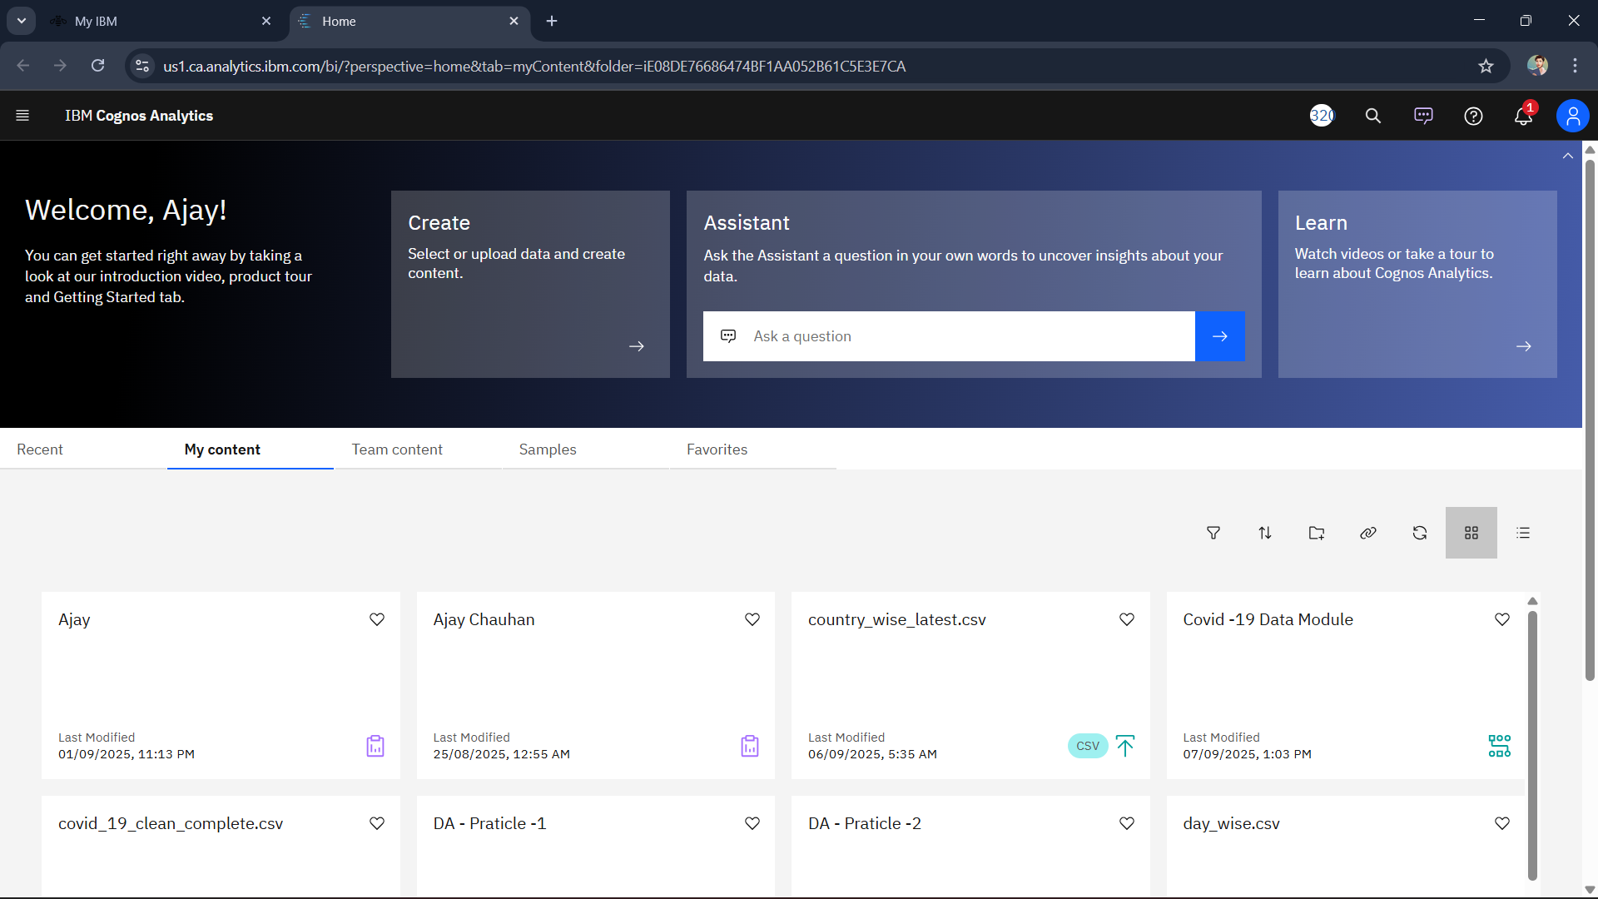
Introduction
Dataset Description:
This dataset contains data from Netflix
movies & TV shows.
Tool:
We used IBM Cognos Analytics to
analyse and visualise the data.
Problems Selected:
Year-wise Title Count
Movies vs TV Shows
Yearly Title Count (Using Exploration)
Pie Chart Percentage Share
Country-wise title count

Slide 3
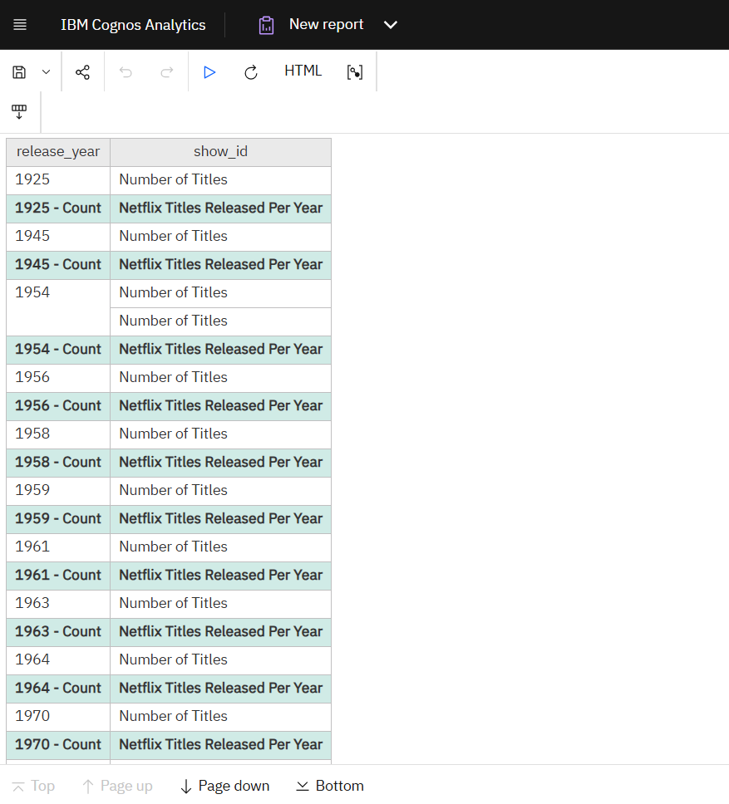
Year-wise title count
Used the release_year column from the dataset
Created a List Report in IBM Cognos Analytics
Added two fields: release_year and show_id
Grouped the rows by release_year
Applied Count(show_id) to calculate the number of titles
released per year
Sorted all years in ascending order
This shows how many Netflix titles came out every year
Helps identify content growth trends over time
Useful to understand Netflix’s “expansion and production
strategy”
Final output clearly shows year-by-year increase in titles

Slide 4
Insights:
Netflix has been releasing more titles every year.
A steady upward trend shows continuous expansion of the platform.
Earlier years have fewer titles → Netflix was still growing.
Recent years show a sharp rise → high investment in content production.
Year-wise data reveals the growth strategy of Netflix.
Netflix’s yearly releases show a strong upward trend, reflecting continuous growth in content production.

Slide 5
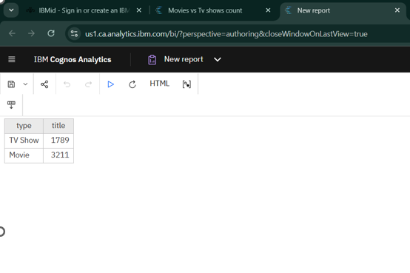
Movies vs TV Shows
Selected the type field (Movie / TV Show)
Added title / show_id for counting
Applied Group to separate Movies and TV Shows
Applied Count to calculate total titles under each
category
This comparison shows which category is more
produced
Highlights Netflix’s content strategy
Helps understand whether Netflix focuses more
on Movies or Shows
Final result: Movies ≈ 3211, TV Shows ≈ 1789 (Number of Movies & TV show by title)

Slide 6
Insights:
Movies are higher in count than TV Shows.
Netflix’s library is more movie-dominated.
TV shows are increasing but still less than movies in total numbers.
Indicates Netflix focuses more on movies for variety.
Category comparison gives a clear idea of content distribution.
Movies dominate Netflix’s content library, showing higher contribution than TV Shows.

Slide 7
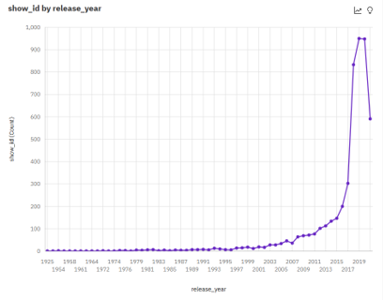
Yearly title count (using exploration)
Using Exploration to show total Netflix titles released each year
Opened Exploration in IBM Cognos Analytics
Added the dataset as the data source
Selected Single Visualisation
Choose the Line Chart visual
Dragged release_year to the X-axis
Dragged show_id to the Y-axis
Applied Summarize → Count(show_id)
The chart displays the “total titles released each year”
Helps visualize yearly growth in Netflix content

Slide 8
Insights:
The line chart shows a consistent upward trend in yearly releases.
Visual analysis confirms that Netflix grew rapidly over the years.
Peaks in the chart represent years with massive content release.
The trend line clearly reflects Netflix’s rising global influence.
Helps understand how content production has changed over time.
Netflix’s yearly releases have consistently increased, showing strong growth in content production.

Slide 9
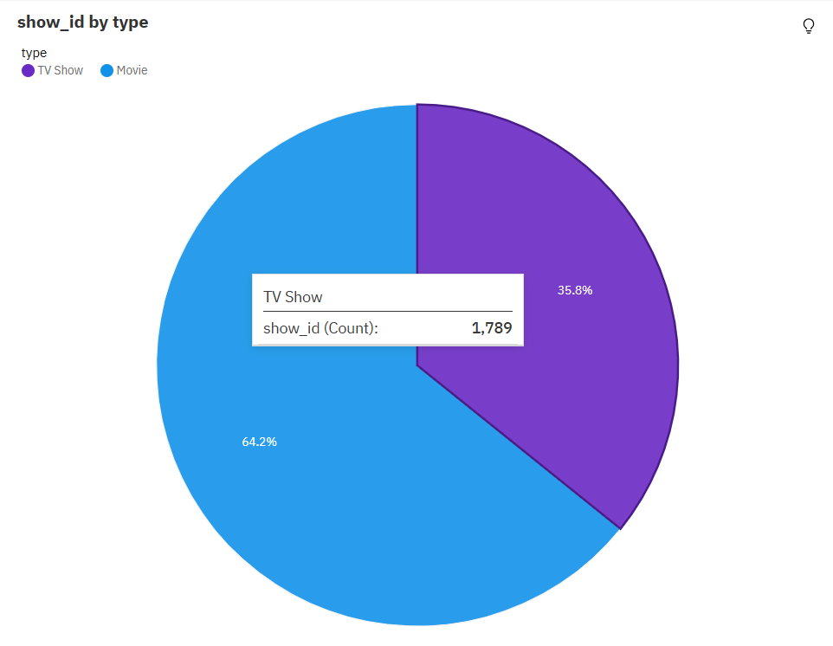
Pie chart (movies vs TV shows % share)
Created a Pie Chart in IBM Cognos Exploration
Used show_id as Measure (Size)
Used type as Category (Segment)
Applied Summarize → Count for numerical values
Turned on Percentage Display
Pie chart gives a clear visual comparison
Shows share of Movies vs TV Shows
Easy to understand distribution at a glance
Output (example):
Movies ≈ 35.8%
TV Shows ≈ 64.2%

Slide 10
Insights:
The pie chart clearly shows which category dominates the platform.
Movies and TV Shows share a balanced but distinct percentage.
Easy to understand the overall content ratio visually.
Helps identify which category Netflix invests in more.
Visual percentage gives a quick summary of content distribution.
• The pie chart clearly highlights which category (Movies or TV Shows) has a larger share on Netflix.
• This distribution reflects Netflix’s strategy to invest more in the category with higher viewer engagement.

Slide 11
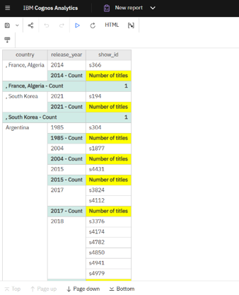
Country-wise title count
Used country field from the dataset
Created a List Report
Grouped titles based on country
Applied Summarize → Count(show_id)
Shows which countries have the highest number of Netflix titles
Helps understand content distribution across regions
Very useful for identifying regional content availability

Slide 12
Insights:
Some countries have much higher content availability than others.
The United States, India, and the UK appear among the top contributors.
Shows how Netflix targets different regions and markets.
Indicates regional content dominance and user preferences.
Helps analyse which countries have a strong Netflix presence.
The list report reveals that certain countries, especially the US and India, contribute the highest number of Netflix titles.

